Slide 1

BBrraannddiiffyy
Revolutionizing Branding
Presented by [Your Name] on February 26, 2026

Slide 2
Branding Challenges
Overcoming Obstacles in Branding
Costly Processes
Inconsistent Quality
Startups and creators often face time-consuming branding processes that drain resources. High costs can hinder their ability to effectively establish a presence in competitive markets.
Achieving consistent brand identity and content quality proves challenging for many. Variability in branding can confuse customers and weaken overall brand recognition in the marketplace.

Slide 3
70%
Branding Consistency Struggles
This statistic highlights the significant challenge faced by startups, emphasizing the need for efficient branding solutions that ensure consistency and speed in their development processes.

Slide 4
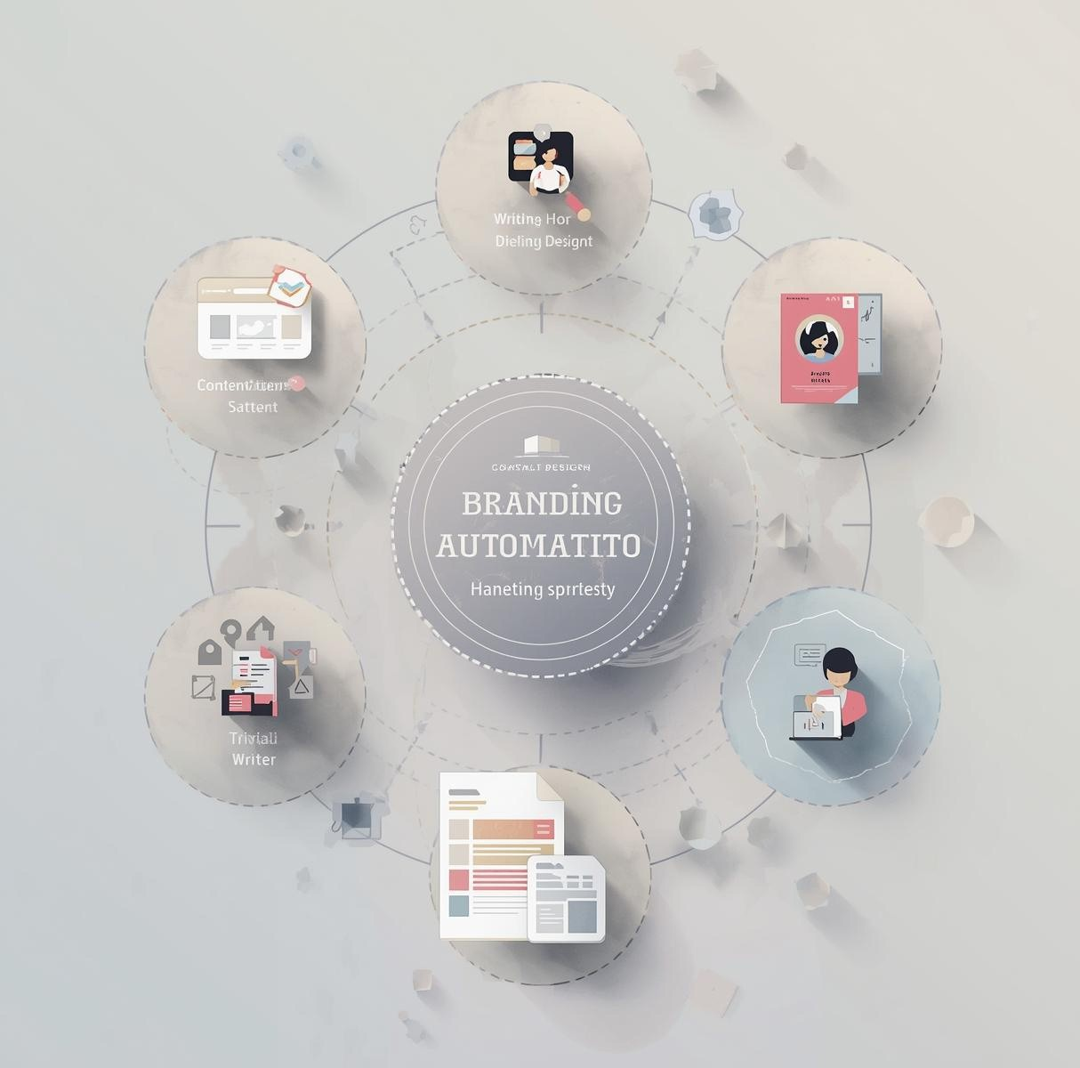
Integrated Branding Workflow
Seamless Automation
Our platform simplifies brand development by automating identity creation, content writing, and visual asset generation, ensuring consistency and speed for startups and creators alike.

Slide 5
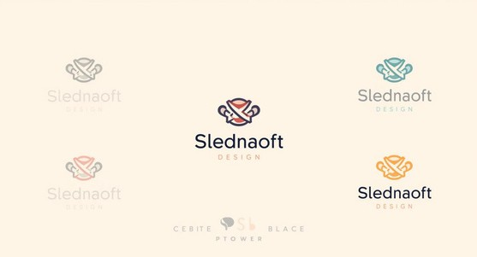
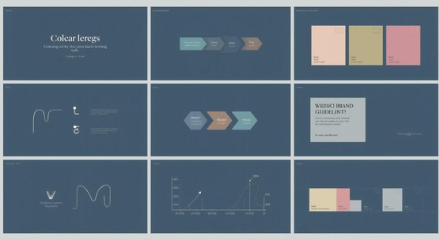
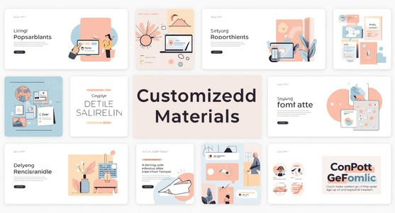
Logos
Elevate Your Brand Identity Effortlessly
AI-generated logos tailored to your unique vision.
Guidelines
Automated brand guidelines ensure consistency across platforms.
Templates
Customizable templates guarantee uniqueness and flexibility.

Slide 6
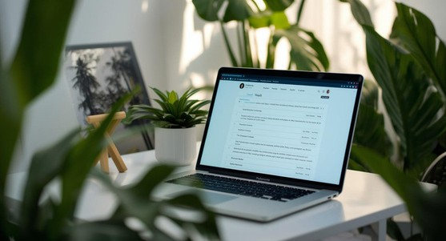


Brand Stories
Streamlining Content Creation with AI
AI creates engaging narratives that resonate deeply.
SEO Optimization
AI ensures content ranks well on search engines.
Adaptive Style
Writing adjusts to match unique brand voices effortlessly.

Slide 7
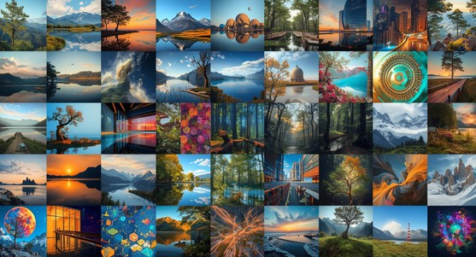
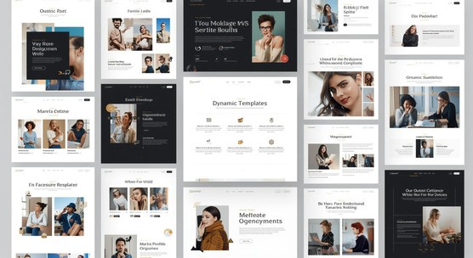
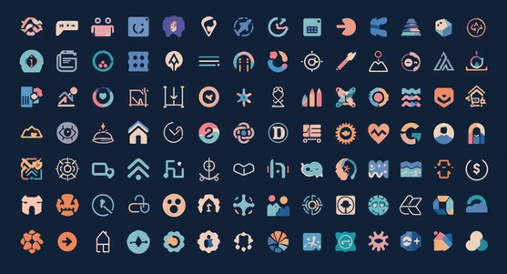
Image Creation
Enhancing Visuals with AI Generation
AI generates unique images for various needs.
Dynamic Templates
Customizable templates ensure tailored branding experiences.
Visual Consistency
Maintain a cohesive style across all assets.

Slide 8
Traditional Branding Challenges
AI-Powered Integrated Workflow
Manual processes lead to inefficiency Fragmented tools create inconsistency Slow turnaround times delay market entry
High costs associated with multiple resources
The AI-driven approach automates branding tasks, enhancing efficiency. It ensures a cohesive brand presence across channels and accelerates the development process. This leads to significant time and cost savings while maintaining high quality and consistency throughout branding efforts.

Slide 9
User Journey
Vision
Generation
Creation
Review
Input your brand vision to guide the AI's creative process.
The AI generates your brand identity and guidelines seamlessly.
Content and visuals are automatically created based on your brand's needs.
Customize and launch your brand assets with ease and efficiency.

Slide 10

Get Started Today
Empower Your Brand
Experience the future of branding with our AI-driven platform. Simplify and enhance your branding process, ensuring a strong identity and visual appeal for your business.

Slide 11

Thank You
We appreciate your interest in our branding platform.
Phone: 123-456-7890
Email: hello@reallygreatsite.com Website: www.reallygreatsite.com

